Slide 1
Bioeconomy and Sustainability
By Veronica Ward

Slide 2
Lesson 1: What is Renewable and Non-Renewable Energy?

Slide 3
Understanding Energy Usage
Introduction to the impact of non-renewable energy on climate change
Find environmentally friendly energy alternatives
Define "energy" and "energy source"
Mentimeter activity
Wordle visualization of student responses.

Slide 4
Types of Energy
Energy categorization: renewable vs. non-renewable
Interactive board or whiteboard/chalkboard activity
Brainstorming session with students to list energy sources
Classifying sources under renewable and non-renewable headings
Reflection on local energy consumption and geographical factors

Slide 5
Reflecting on Impact
Encourage students to reflect on positive and negative impacts of different energy sources
Discussing environmental, social, and economic consequences
Guided discussion to help students understand complex concepts
Highlighting the importance of considering sustainability in energy choices
Emphasizing critical thinking and analysis skills

Slide 6
Supply Challenges
Identifying easiest/most difficult energy sources to increase supply
Padlet activity for students to share opinions
Exploring reasons behind supply challenges
Factors such as technology, infrastructure, and resource availability
Teacher engagement: commenting on student responses to deepen understanding

Slide 7
Conclusion and Next Steps
Recap of key learnings on energy usage and sustainability
Encouragement for continued exploration of renewable energy solutions
Call to action: brainstorming ways to promote renewable energy in the community
Importance of individual and collective action in addressing climate change
Invitation for ongoing dialogue and reflection on energy choices

Slide 8
Social Science - Lesson 2: Renewable Energy in Transport

Slide 9
Exploring Modes of Transport
Activity: Students list and discuss modes of transport they regularly use
Visual aids: Display images of various transportation modes
Interactive sorting activity on the board:
Sort by things with/without wheels
Sort by ways I have/have not travelled to/from school
Sort by greener/wasteful ways to travel
Sort by things that use fuel/human energy to move
Discussion on alternative classification methods proposed by students

Slide 10
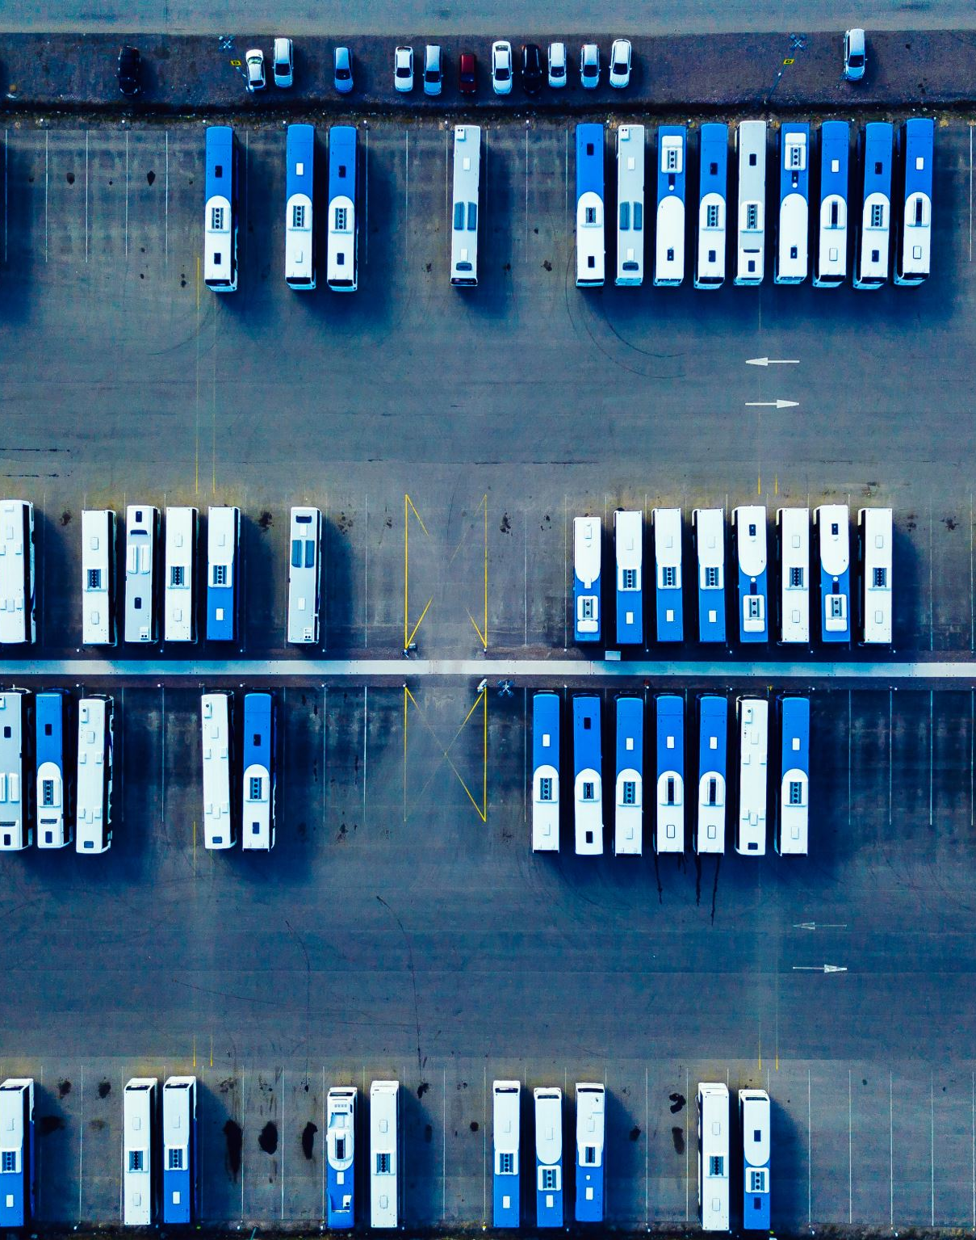
Environmental Impact
Discussion on how distance impacts mode of transport choice
Exploration of greener transport options:
Public transport benefits in reducing car emissions
Examples of eco-friendly vehicles (e.g., hydrogen fuel cell buses)
Explanation of how certain modes of transport are greener for the environment
Linking transportation choices to pollution and health effects

Slide 11
Traffic Survey
Explanation of the traffic survey task
Details on how students will collect and record traffic data
Example tally chart shown and explained
Reference to resources for tally chart explanation
Video demonstration of a traffic survey for visual understanding

Slide 12
Data Analysis
After survey, students graph their results (bar graph/pie chart)
Discussion on the local community's transportation choices based on data
Analysis of trends and patterns in transportation data
Encouragement for critical thinking about transportation impacts on the environment

Slide 13
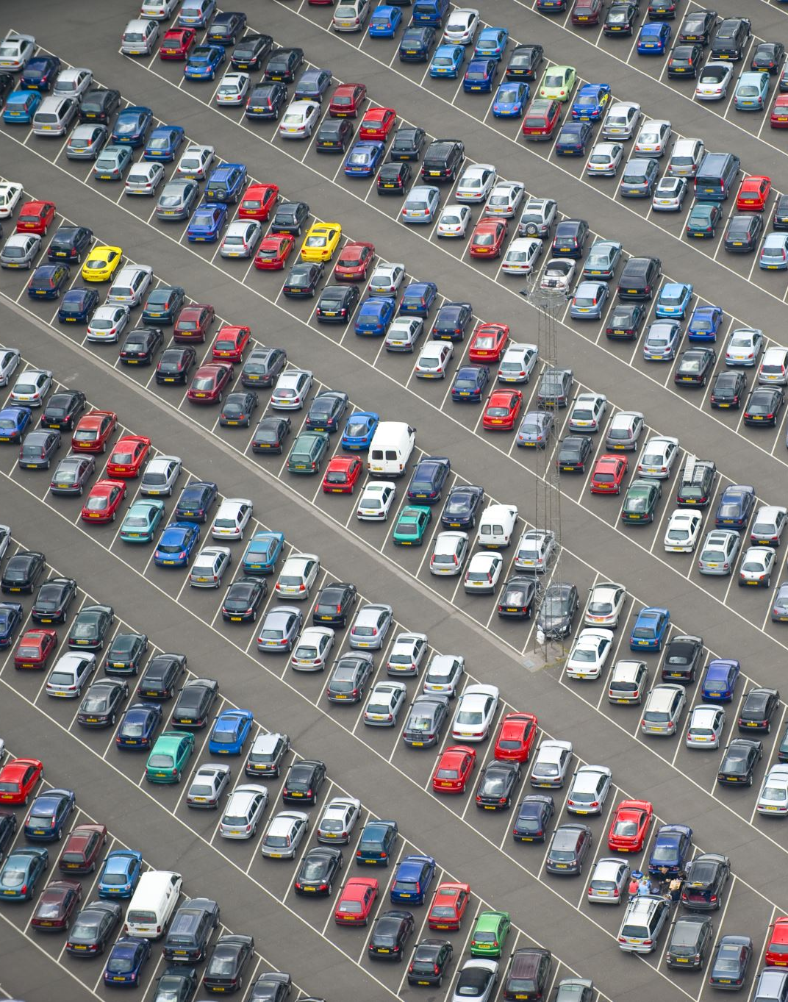
Promoting Greener Transport
Brainstorming session on motivating peers to use greener modes of transport
Discussion on the environmental harm caused by certain transport modes
Highlighting the role of cars in air pollution
Sharing knowledge on alternative fuels and eco-friendly vehicles
Activity: Designing eco-friendly vehicles as a creative exercise

Slide 14
Natural Science - Lesson 3: Renewable Energy in Buildings

Slide 15
Energy Detective Challenge
Task: Students become energy detectives in the classroom
Use of tablets/smartphones/cameras to photograph energy-using items
Discussion on items found (computers, plugs, lights, heating systems, etc.)
Reflection on previous awareness of energy-consuming items
Exploration of different types of energy used in the classroom

Slide 16
Energy Sources Analysis
Explanation of heat, power, and light energy usage in classroom items
Discussion on tracing energy sources back to renewable/non-renewable resources
Encouragement for critical thinking about greener alternatives
Prompting students to consider the necessity of specific energy resources

Slide 17
Energy Consumption Survey
Introduction to conducting a survey on energy consumption
Example survey questions provided (see Annex III)
Explanation of survey methodology and its importance
Estimation activity: Percentage of cold air escaping from a refrigerator
Tally chart recording of student responses

Slide 18
Energy Efficiency and Ratings
Introduction to energy-efficient products
Video demonstration of EU electrical appliance ratings
Discussion on the benefits of energy-efficient products
Link between energy-efficient products, cost savings, and environmental impact
Exploration of ways to promote energy efficiency in daily life

Slide 19
School Energy Survey
Invitation of school head and caretaker to the class
Students asking survey questions (see Annex III) and additional queries
Discussion on changes made to reduce energy consumption in school
Suggestions for making the school more energy efficient
Encouragement for students to complete the home survey (see Annex IV) and compare findings
Reflection on survey impact on energy awareness at home and in school

Slide 20
Natural Science - Lesson 4: Use of Renewable Energy in the national power grid

Slide 21
Exploring Green Energy
Introduction to hydroelectric power and wind power
Importance of transitioning to low carbon, greener energy sources
Discussion on environmental benefits and reducing carbon emissions
Encouragement for students to brainstorm questions and topics for a power station visit
Focus on the role of renewable energy in combating climate change

Slide 22
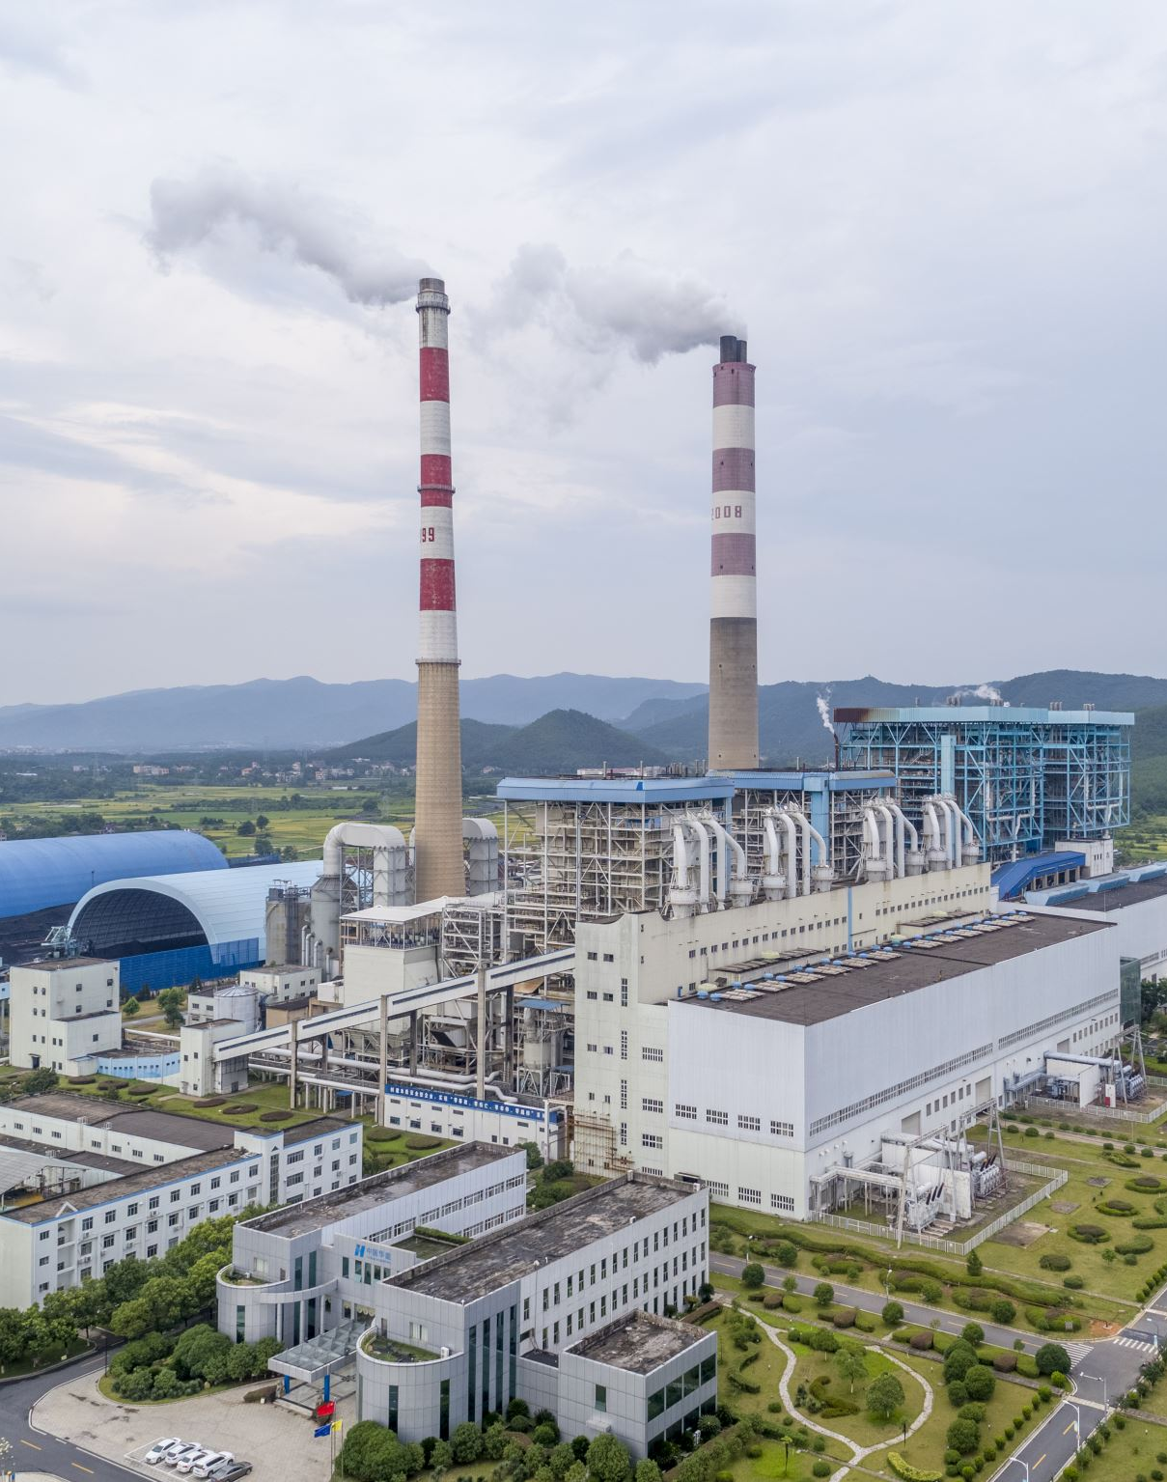
Hydroelectric Power Station Visit
Explanation of planned school visit to a hydroelectric power station
Possibility of physical or virtual visit to engage with professionals
Example video of a hydroelectric power station
Consideration of alternative options if local visits are not feasible
Emphasis on direct interaction with experts to learn about recent developments

Slide 23
Student Video Reports
Task: Students film 3-5 minute video reports on their power station visit
Alternatively, students report on information acquired from online videos
Upload videos to virtual classroom for sharing
Discussion on the importance of sharing knowledge with other classes
Option: Creation of information posters to disseminate findings to families and community

Slide 24
Reporting Experience
Focus on the storytelling aspect of the video reports
Encouragement for students to share their personal experiences and insights
Highlighting the significance of student voices in raising awareness
Discussion on the impact of visual media in conveying information effectively
Exploration of creative ways to engage with peers and wider audiences

Slide 25
Empowering Change
Reflection on the learning journey and experience gained
Discussion on how student actions can contribute to positive change
Empowerment to continue exploring and advocating for renewable energy
Call to action: Encouraging peers and community members to embrace green energy
Recognition of students' efforts in promoting sustainability and environmental awareness

Slide 26
English and Arts - Lesson 5: Presentation of Renewable Future Plan

Slide 27
Reflection on Learning
Brainstorming session to recall key points on renewable and non-renewable resources
Reflection on understanding of energy consumption and conservation
Encouragement for students to consider personal actions for energy conservation
Preparation for in-depth research on specific energy sources within the local area
Emphasis on developing comprehensive knowledge and understanding

Slide 28
In-Depth Research
Group assignment: Research on assigned renewable/non-renewable resource
Guidance on research focus areas: description, location, recovery processes, storage, release, advantages/disadvantages, environmental impact, future role
Resource suggestions for research assistance
Importance of thorough understanding for effective poster and presentation creation
Opportunity for students to develop research and critical thinking skills

Slide 29
Poster and Presentation Creation
Task: Create a poster and short PowerPoint presentation on researched energy source
Encouragement for creativity and visual appeal in poster design.
Focus on clear and concise presentation content
Option to record presentations for upload to school social media channels
Opportunity for students to showcase learning and public speaking skills

Slide 30
Student Self-Assessment
Introduction to student self-assessment rubric (see annex V)
Encouragement for students to reflect on their contribution to group work
Evaluation of individual strengths and areas for improvement
Emphasis on self-reflection as a tool for personal growth and development
Opportunity for students to take ownership of their learning journey

Slide 31
Peer Review
Explanation of peer review process using Padlet
Instruction for students to upload 2 stars (elements of strong communication) and a wish (areas for improvement) for each group presentation
Importance of constructive feedback in supporting peer learning
Opportunity for students to engage in collaborative learning and communication
Emphasis on fostering a supportive and inclusive learning environment

